Slide 1
My Company Tab

Slide 2
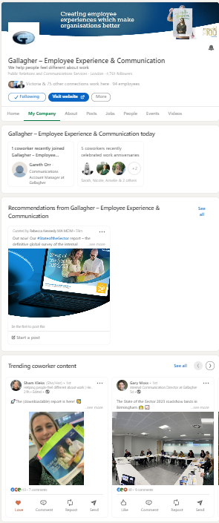
What is the My Company tab
Gallagher Today
Recommendations from Gallagher
Trending coworker content
People you may know at Gallagher
How to access: Go to our company page and click the “My Company” Tab. Next, verify your work email address. LinkedIn will send you a 6-digit code for verification.
Notes:
The My Company Tab is an Exclusive Employee Experience that lives on the Gallagher Company Page on LinkedIn.
So it is essentially a tab that only you will have access to as an employee.
The tab consists of 4 sections, Gallagher Today, People You May Know, Trending Coworker Content, and Recommendations from Gallagher.
Recommendations from Gallagher is what we’ll be focusing on. This section is where we deliver preapproved and pre-packaged social media posts for you to share to your professional networks on LinkedIn and Twitter in just a few clicks.
Our Curators, the Marketing and Comms people across brands, divisions, and regions put these posts together, finding the articles, and writing the post copy that you can share as yourself with very little effort.

Slide 3
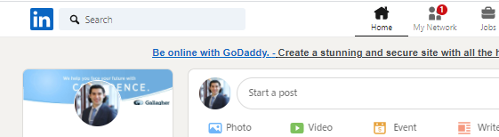
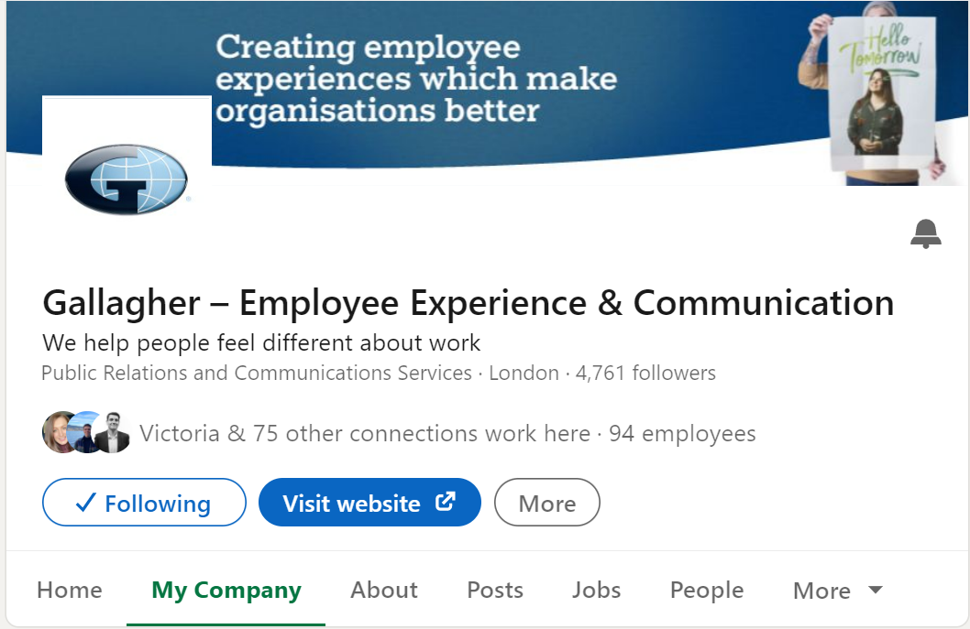
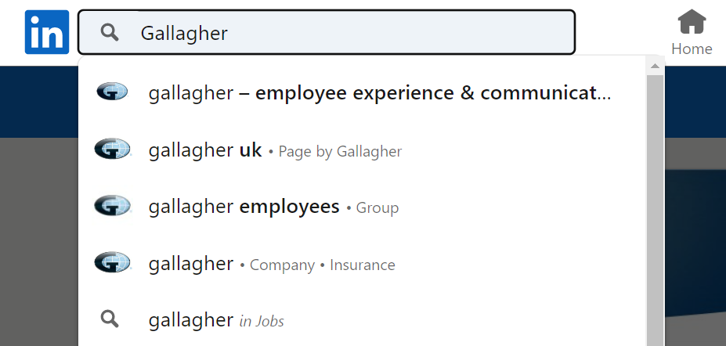
Finding the My Company Tab
3.
1.
2.
Note: Search for Gallagher & click our company page (it looks like that^)

Slide 4
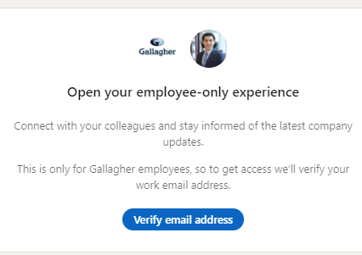
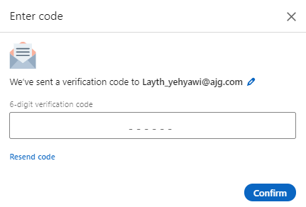
Activate My Company Tab | 2 Steps
1.
2.
Notes:
Put the link in the chat and invite them to follow along.
If you are not seeing the code, or the code doesn’t work after you put it in (loop) Edge or I.E
Use Chrome!

Slide 5
You’re In!

Slide 6

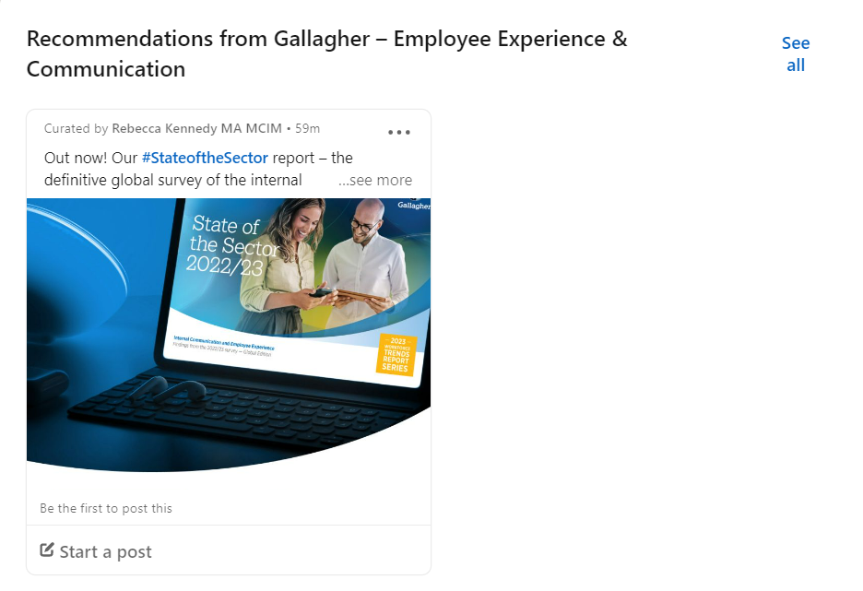
Posting From Your Feed
Select a post you want to share
Click “Start a post”
Add your perspective or share as is.
Reminder: don’t delete the link on accident!
Publish
Your post is live and has been shared with your network!

