Slide 1

Our 2022 proposition
Internal communication & EX
June 2022 – Internal use only

Slide 2
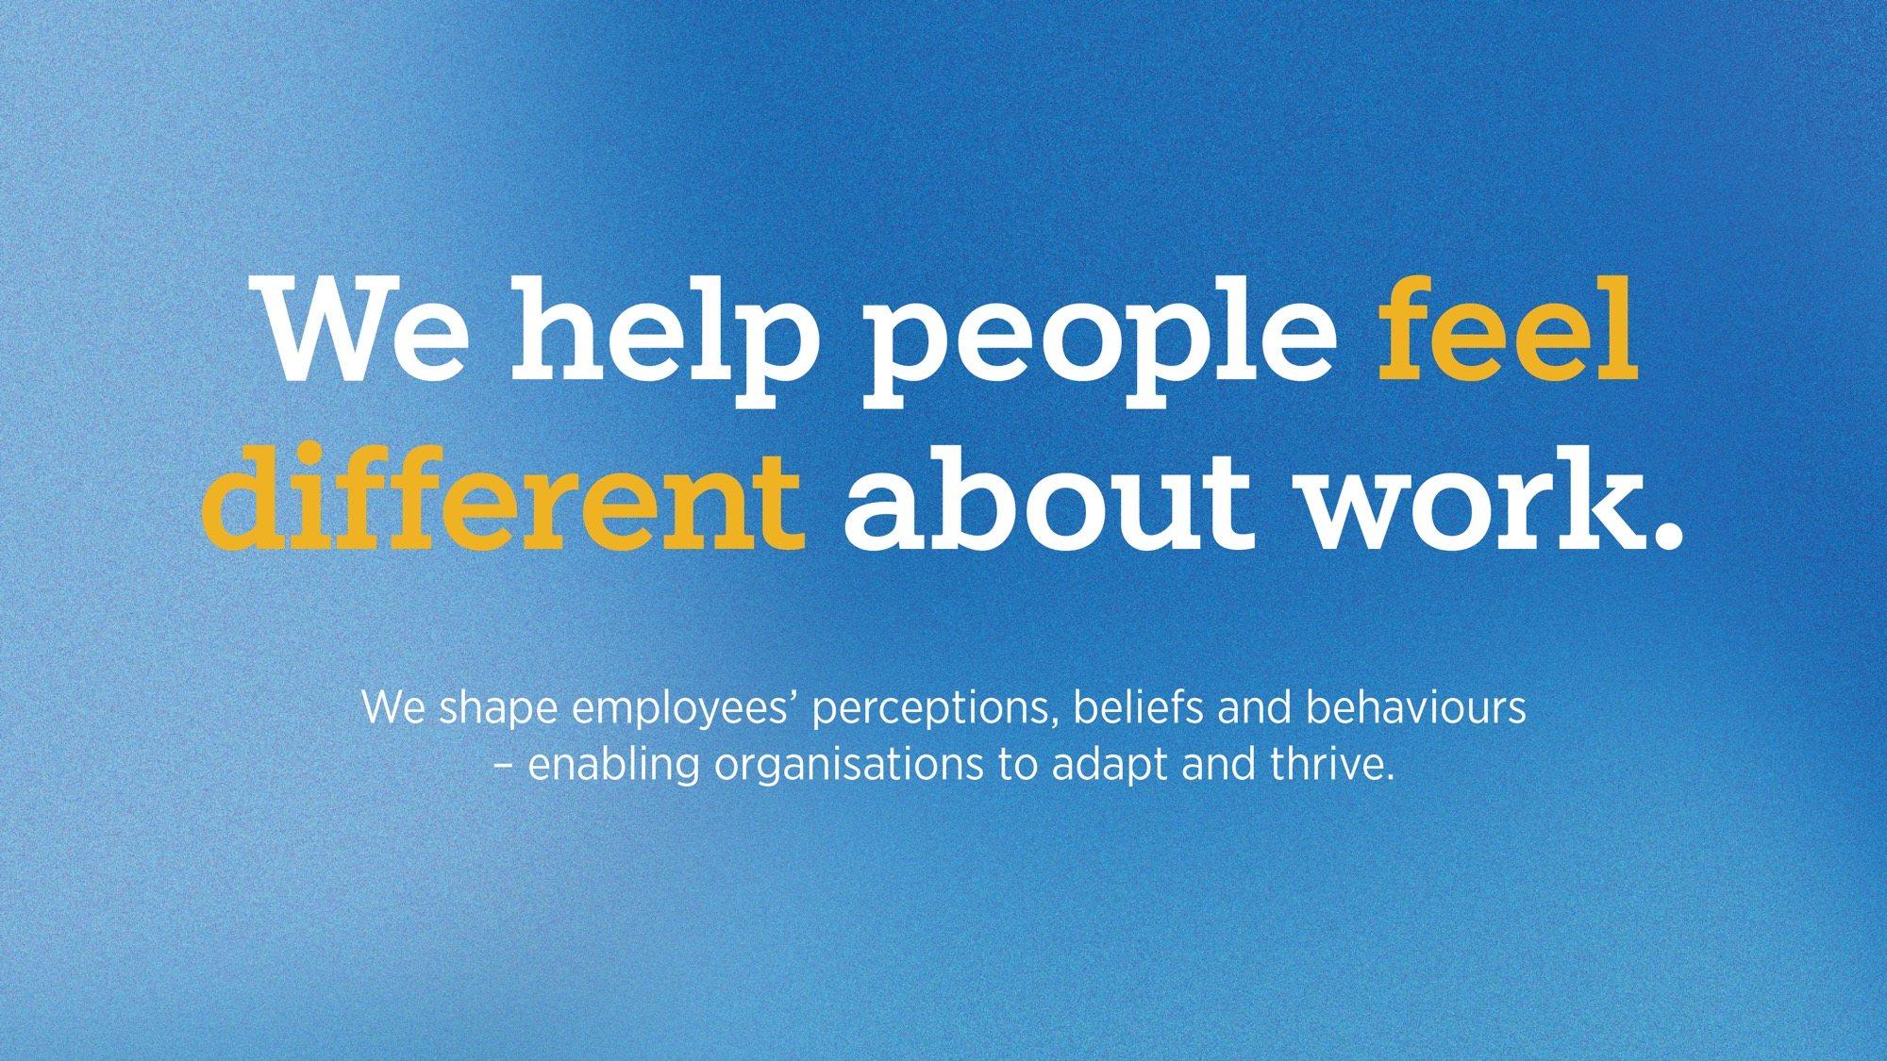

Slide 3

Delivering value at every step.
Employee Value
proposition (EVP)
The unique and differentiating promise that you make to your people, their family, and to candidates that enables them to live a better way with you.
Employee experience (EX)
How your bring your promise to life though everyday experiences and a consistent application of all forms of communication and interaction.
Employer brand strength
Talent attraction
Talent retention
Alignment
Productivity & performance
Employee advocacy

Slide 4

Meaningful employee experiences.
Purpose, strategy and culture
What you believe in, where you’re going and how it ‘feels’ to work here
Communication excellence
How you engage and bring people on the journey
Ways of working
How your people are equipped to do their work
EX touchpoints
Our approach to Employee Experience (EX) guides how we tackle our clients’ challenges and come up with holistic communication solutions.
Career
How you empower your people to develop, grow and thrive in their role
Rewards, benefits and retirement
What employees ‘get’ for their efforts, expertise and loyalty
Wellbeing
How you support your people’s physical, mental, financial and social wellbeing

Slide 5
Communicating why you do what you do, what you do and how you do it.
Purpose, strategy and culture
What you believe in, where you’re going and how it ‘feels’ to work here
Communication excellence
How you engage and bring people on the journey
Ways of working
How your people are equipped to do their work
Engaging employees in your direction of travel and connecting employees to your purpose, vision, strategy and values
Helping leaders and people managers become evangelisers for your vision
Creating internal engagement around your Environmental, Social, and Governance objectives, including D&I
EX touchpoints
Career
How you empower your people to develop, grow and thrive in their role
Rewards, benefits and retirement
What employees ‘get’ for their efforts, expertise and loyalty
Wellbeing
How you support your people’s physical, mental, financial and social wellbeing

Slide 6
How you equip your people to thrive and interact with each other.
Purpose, strategy and culture
What you believe in, where you’re going and how it ‘feels’ to work here
Communication excellence
How you engage and bring people on the journey
Ways of working
How your people are equipped to do their work
Hybrid engagement – enhancing your working spaces, introducing new digital platforms, encouraging your desired behaviours in a hybrid environment
Business transformation – support the adoption of new business processes as part of M&A, digital transformation or culture change projects
Embedding safe working practices through compliance communications that address the risks linked to health and safety, cybersecurity, data protection or counterfeit
EX touchpoints
Career
How you empower your people to develop, grow and thrive in their role
Rewards, benefits and retirement
What employees ‘get’ for their efforts, expertise and loyalty
Wellbeing
How you support your people’s physical, mental, financial and social wellbeing

Slide 7
Purpose, strategy and culture
What you believe in, where you’re going and how it ‘feels’ to work here
Empowering people to manage their wellbeing.
Communication excellence
How you engage and bring people on the journey
Ways of working
How your people are equipped to do their work
Developing authentic, emotive and impactful Total Rewards communications that help your people realise the value of what they ‘get’ from working with you
Designing positive financial, mental and physical wellbeing experiences that let employees make more informed decisions and better leverage their benefits
We design effective and manage pensions communication that build your people’s confidence in their long-term financial future
EX touchpoints
Career
How you empower your people to develop, grow and thrive in their role
Rewards, benefits and retirement
What employees ‘get’ for their efforts, expertise and loyalty
Wellbeing
How you support your people’s physical, mental, financial and social wellbeing

Slide 8
Purpose, strategy and culture
What you believe in, where you’re going and how it ‘feels’ to work here
Enabling people to thrive in their role.
Communication excellence
How you engage and bring people on the journey
Ways of working
How your people are equipped to do their work
Helping you attract the right talent and create a positive onboarding experience for new joiners, winning their hearts and minds from the very beginning with personalised experiences
Empower your people to understand how they can build their careers in your organisation and move up to the next phase of their development
Communicating all components of your people strategy, from learning and development and performance management through to recognition and succession planning
EX touchpoints
Career
How you empower your people to develop, grow and thrive in their role
Rewards, benefits and retirement
What employees ‘get’ for their efforts, expertise and loyalty
Wellbeing
How you support your people’s physical, mental, financial and social wellbeing

Slide 9
Purpose, strategy and culture
What you believe in, where you’re going and how it ‘feels’ to work here
Achieving communication excellence
Communication excellence
How you engage and bring people on the journey
Ways of working
How your people are equipped to do their work
Aligning your internal communications to your purpose and strategy and setting up your communication function for success with a clear communication strategy
Auditing your internal communications to explore how your channel ecosystem, narrative and tone of voice impacts your employee experience
Developing channel strategies that promote open dialogue and collaboration informed in an increasingly hybrid working environment
EX touchpoints
Career
How you empower your people to develop, grow and thrive in their role
Rewards, benefits and retirement
What employees ‘get’ for their efforts, expertise and loyalty
Wellbeing
How you support your people’s physical, mental, financial and social wellbeing

Slide 10




How we do it
Insights & Research
Stakeholder workshops
Communication audits
Campaign measurement
Audience personas
Strategy
Communication strategy
Employer Value Proposition
Strategic narratives
Activation plans
Creative
Branding
Internal campaigns
Videos and animations
Toolkits
Guides
Digital
Websites and portals
Apps and games
Modellers and calculators
Decision support tools
Personalised rewards and benefits statements

Slide 11
Why partner with us?
Holistic solutions
By tapping into the expertise of the wider Gallagher team, we tackle your business challenges from every angle.
Trusted partners
We support some of the world’s most progressive employers and deliver, working as an extension of their team.
We have a 25-year record of success in creating engagement and driving behaviour change and are globally renowned thought leaders in all things internal communication and employee experience.
Outcome-focused
We're hell-bent on making organisations better by linking everything back to a strategic business objective.
Creative + Innovation
We know what world-class looks like — you don't build a client roster like ours if you don't stay ahead of the curve.

Slide 12





























You’re in good company

Slide 13
Agnes Costa
Agnes_Costa@Ajg.com

